Slide 1
The Last Houses of Frogtown: Preservation & Interpretation of a Forgotten Savannah Neighborhood
Emily Beck, Director of Interpretation, Coastal Heritage Society
Notes:
CHS is a 501(c)3 nonprofit organization founded in 1975 that operates 7 historic sites and museums in Savannah, Georgia.

Slide 2
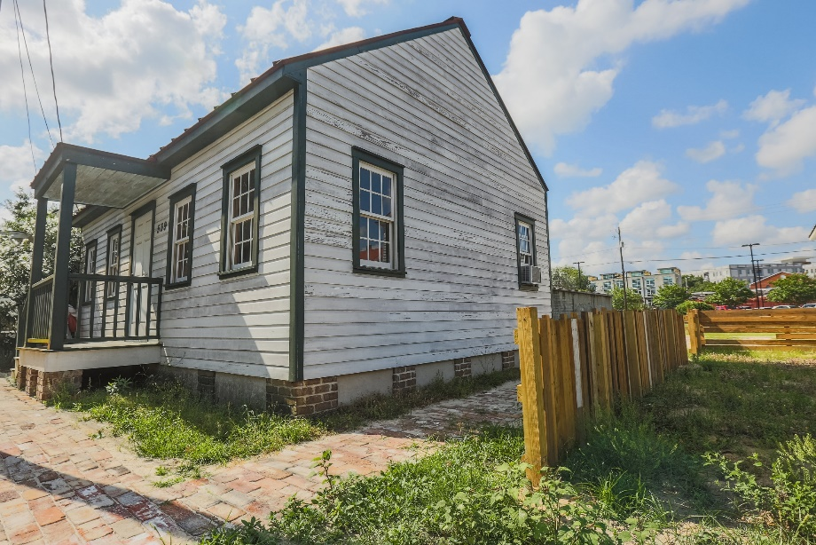
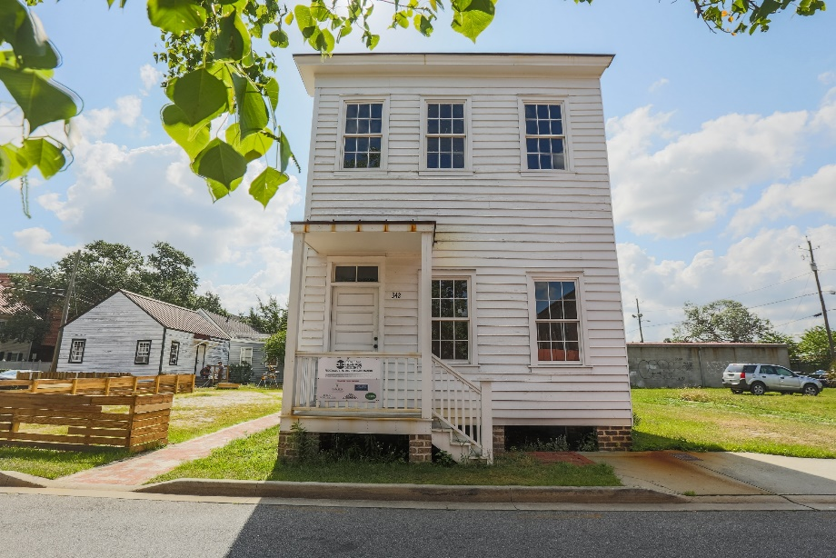
Frogtown Tenements
Charlton Street House
Build Date ca 1880
Single-story wood frame vernacular
Interpretation will focus on mid-19th century Irish immigration
Purse Street House
Build Date 1890
Two-story wood frame vernacular
Interpretation will focus on African American story into the 20th century
Notes:
Frogtown Tenements includes two historic homes located next door to Georgia State Railroad Museum and nearby Savannah History Museum in downtown Savannah, Georgia. The smaller of the two houses pictured dates to about 1880, perhaps as early as the 1870s. The larger of the two houses was built in 1890. Both of these structures were once owned by an African American family, The Coopers, and the Cooper family lived in the Purse Street House into the early 2000s. These are two of the last three residential structures left from the Frogtown neighborhood which surrounded The Central of Georgia’s repair shop facility on the west side of Savannah. The third structure is similar to the Charlton Street House, located next door to it, and is privately owned.
These photos are from the most recent professional photo shoot of the houses and were taken last fall. Both houses have been restored to their historic build date appearances. The Charlton Street House was originally located across Jones Street (street area slightly visible behind Charlton Street House) and was moved to its current location. Both houses are now in what was historically called Railroad Ward. The Central of Georgia Railway repair shops complex is across the street, but the Central did not build, own, or rent the houses in Frogtown; all were built and rented out by independent landlords.
Currently, we offer 30 to 45-minute walking tours of the houses and the surrounding area, billed as pilot tours for Savannah History Museum visitors and included in the ticket price along with other programming. The Last Houses of Frogtown: Preservation of a Forgotten Savannah Neighborhood focuses on the houses and their construction and the neighborhood more generally, and uses images and maps to help visitors understand the significance of the neighborhood. At this time, we are gathering more information about the houses and the neighborhood in order to expand the tours in the future, both with guided programming, and exhibits/historically accurate interiors inside the houses.

Slide 3
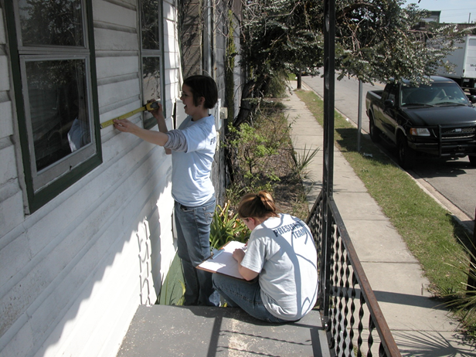
Preservation
CHS led the fight against demolition of these houses.
Purchased both in the early 2000s.
CHS carried out structure moves, extensive documentation of both structures, and archaeology of Railroad Ward.
Notes:
In the early 2000s, both structures were slated for demolition. By this point, most of the structures in Frogtown had been demolished. The Charlton Street House, the smaller of the two structures was moved to Railroad Ward at this time. The lot where both houses are now is a lot that belongs to CHS, but surrounding land does NOT belong to us.
Among the reasons given for demolition was that the houses did not demonstrate artistic/architectural value. CHS demonstrated artistic/architectural value in each houses with design elements. In the Charlton Street House, CHS cited the decorative wainscot in the center hallway, and in the Purse Street House, CHS cited the bannister along the staircase near the entrance of the house. CHS demonstrated the value of these houses as representative of the working class areas of the city on the west side of the city, especially since many similar neighborhoods have since been demolished or replaced. A major African American business and entertainment corridor along Martin Luther King Blvd, formerly West Broad Street, has been incrementally disappearing since the 1970s. This corridor bordered Frogtown on its east side. Failure to preserve these houses would be a continuation of that destruction of working class and African American culture.

Slide 4
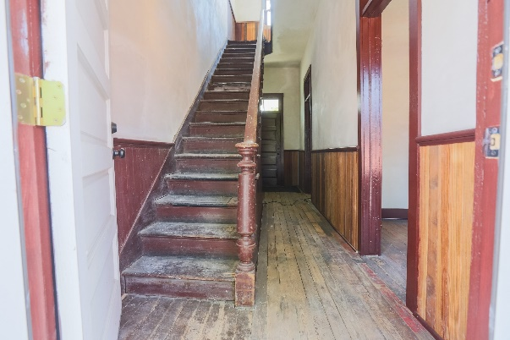
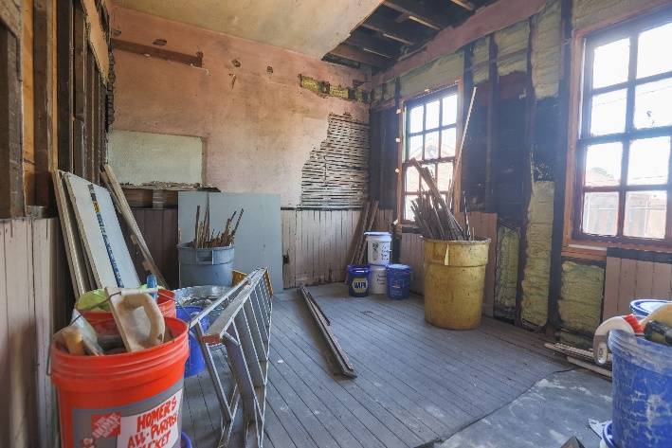
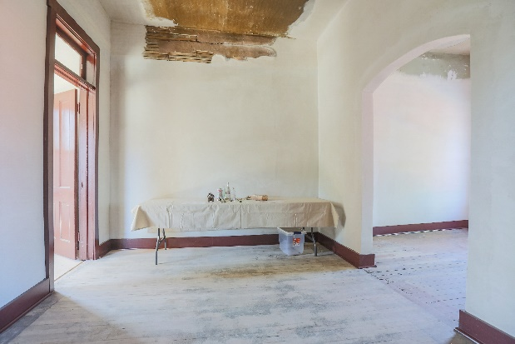
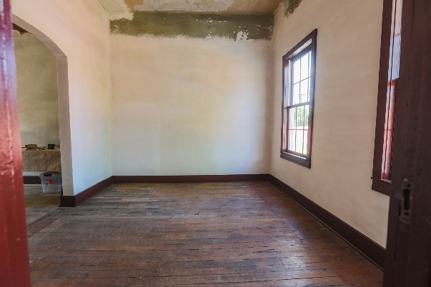
Preservation
Notes:
In the last two years, CHS has begun more work on the exterior and interior spaces of these houses.
Decorative wainscot is visible in the top left photo; decorative bannister visible in the top right photo.
Our objectives in restoration and preservation of these structures were to take them back to their 19th century profiles and to preserve as much of the interiors as possible. Both structures had 20th century additions – Purse Street addition was much larger and was a kitchen and laundry area up into the early 2000s. In the photos, you can see original plaster and some restore plaster. Each of the rooms in the Purse Street House has a different color plaster. Stoops were also added onto both houses both to facilitate walking tours and to restore historic appearances (depending on the location of the stoop).
We have also included rooms where work is continuing restoring historic plaster so that visitors can see historical construction techniques. The outsides of the houses have been painted, but upkeep is performed in a way in which wear shows so that it is consistent with historical photographs of the neighborhood. Roofs were coated in a preservation-created paint which provides the appearance of rust but protects the structural integrity of the roof itself – also done to present an accurate view of what houses in Frogtown actually looked like historically.
Other institutes have aided in this project; among those are Historic Savannah Foundation, and Savannah Tech (which now has an extensive preservation program).
You’ll notice that the interiors are mostly empty due to the lack of photographs and/or descriptions of the interior of Frogtown houses. We have left some film props in the Charlton Street House temporarily to help tour participants picture the houses with people living in them.

Slide 5
The Story of Frogtown
Frogtown as a neighborhood appears to have existed as early as the mid-19th century.
The neighborhood surrounds the Central of Georgia Railway repair shops complex, which was first completed by 1855.
Frogtown is initially a diverse neighborhood, but a demographic shift happens quickly at the turn of the 20th century.
Notes:
In the 18th century, what became Frogtown was comprised of garden lots, or plots used by city residents for food gardens. Residential housing begins to appear around the 1840s and records show that in the mid-to late 19th century, a large portion of Frogtown residents are Irish immigrants. The Irish immigrants are largely single men, coming straight from Ireland, although there are families and single or widowed women as well.
In the 19th century, Frogtown is also largely African American (1888 – 57% white, 42% African American), but a significant demographic shift occurs over a 10-ish-year period between 1888 and 1899 (1899 – approx. 60% African American and 40% white). It is also likely that enslaved people lived in what would become the west end of Frogtown along the Savannah-Ogeechee Canal, still visible from what is left of the Central’s shops complex (now Georgia State Railroad Museum).
Jobs of Frogtown residents include railroad work, dock work, various kinds of drivers, shopkeepers, boarding house owners, etc.
Image is from an 1871 bird’s eye view of Savannah and shows where Railroad Ward and the current site of Frogtown Tenements. Also visible are the still extant Central of Georgia Railway station (currently a Savannah Visitor Center and Savannah History Museum) and some repair shop buildings that are currently part of Georgia State Railroad Museum.

Slide 6
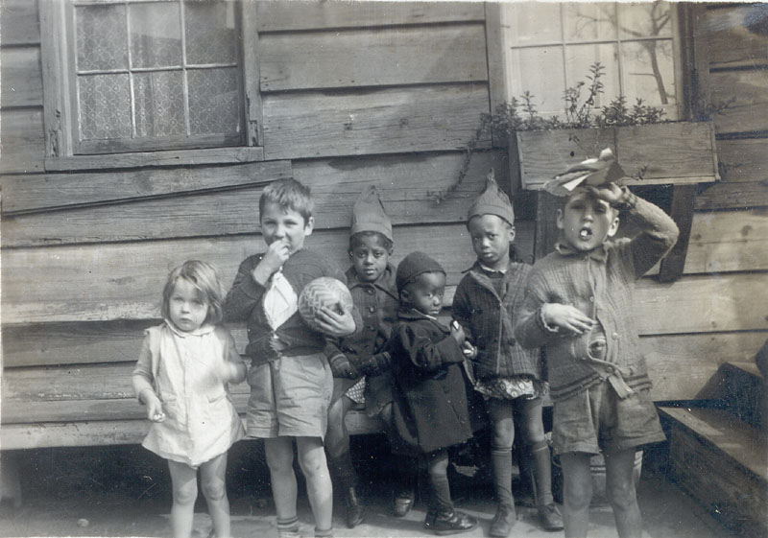
The Story of Frogtown
Residents of Frogtown performed jobs essential to Savannah’s social and economic functioning.
Also documented among residents were Chinese and Jewish people and families, most operating businesses in Frogtown.
Businesses included grocery stores and betting shops.
Notes:
We know that residents of Frogtown were performing jobs which were essential to the social and economic function of Savannah.
Chinese and Jewish immigrants also owned businesses in Frogtown throughout much of its history and are remembered in current Frogtown Reunion literature.
Photos: First photo is not documented as Frogtown, but perhaps of a nearby area or other working class area of the city. Lots of marbles were found during Railroad Ward archaeology and may become a focus of interactive interpretation at Frogtown Tenements. The second photo is part of a series of photos from the 1930s done by Armstrong University students documenting inequalities among whites and African Americans in Savannah.

Slide 7
The Story of Frogtown
These photos are HABS/HAER survey photos of the Frogtown area taken after 1963.
By the time these photos were taken, most of the structures had been demolished after being classified as slums.
Today, there are no residents living in Frogtown, although former residents and their families still have an annual reunion.
Notes:
The Central closes its repair shops in Savannah in 1963. By that point, people are still living in Frogtown, but most houses have been demolished or will be by the end of the 20th century. The Coopers are the last family to be living in Frogtown, and the family itself has ownership of property in Frogtown going back all the way to the 1890s.
Photos: Historical American Buildings Survey / Historic American Engineering Record
NOTE: First photo shows Harris Street, which is now an extended stay hotel with residential buildings done in the style of Frogtown houses/boarding houses. The hotel view is helpful to visitors to picture a residential area when walking to Frogtown Tenements from Savannah History Museum on guided tours.

Slide 8
Research
PRIORITIES:
Individual stories of residents
Interior descriptions/photos
Surrounding neighborhood information/stories
Oral histories
Notes:
CHS has 20+ years of research regarding Frogtown including archeological surveys and building documentation. Currently, I have a graduate student at Georgia Southern researching individual stories from Frogtown, and have had members of my interpretive staff looking through city directories, Cadastral Surveys, etc., with the direction of Coastal Heritage Society Preservation Operations Officer Becki Harkness, who was instrumental in the early efforts to save Frogtown Tenements as well as the subsequent preservation efforts. Mrs. Harkness and I attended this year’s Frogtown Reunion, held in the events space at the nearby Ralph Mark Gilbert Civil Rights Museum to encourage attendance at a History Roundup sponsored by the City of Savannah for Frogtown and Yamacraw, a similar nearby neighborhood. We were able to glean some new information from the roundup, but not nearly as much for Frogtown as for Yamacraw.

Slide 9
Interpretation
PRIORITIES:
Telling the stories of individual Frogtown residents and families
Conveying the importance of Frogtown amd similar neighborhoods in the history of Savannah to visitors
Expanding opportunities for exhibits and interpretive signage

Slide 10
Challenges
How can we provide a balanced picture of Frogtown and its residents?
How can we make efforts to control the image of Frogtown for visitors to Savannah not visiting the site itself?
How can we overcome issues with location, specifically parking, site ticketing, and site access?
What sources can we use to help us interpret the stories of Frogtown if we have few primary source materials?
How can we continue research for this project with limited funding?
Notes:
Balanced picture: Trolley companies are already mentioning Frogtown in their tours, but have been heard talking about a quintuple homicide in the Purse Street House, which is not documented at all. Photo shows an article in an African American newspaper about Frogtown – there was a lot of crime in Frogtown, but we do not want that to be the focus of the museum or its image among tourists to the city. Although there was crime, there was also a deep sense of community and interdependence, along with pride about being from Frogtown. Especially since the remaining structures we have were family owned for the better part of 100 years, we would like community to be the focus of interpretation and exhibits.
Many tourists coming to Savannah are looking for a Gone With The Wind –type narrative; GWTW merchandise is sold in gift shops, lots of questions about “Where are the plantation houses?” Frogtown is a story that many people would be interested in, I think, if they knew about it. Response from visitors on pilot tours has been overwhelmingly positive. Although we don’t want a sanitized, GWTW narrative for this site, we also do not want it to be sensationalized and made into a caricature of what Frogtown really was.
LOCATION: Location is a huge issue for us – we are next door to Georgia State Railroad Museum and a short walk from Savannah History Museum, but access is a problem. We have tried tours starting from both locations, but both prove challenging. We also do not have the resources to make Frogtown Tenements an independent site at this time, but even that would bring challenges (parking, ticketing, new construction, etc).
PRIMARY SOURCES: We have some primary source material, but not a lot. Former residents of Frogtown are generally older or very senior – time is an issue for getting oral histories from many of them. We also need photos or descriptions of interior spaces in order to furnish them in an accurate way.
FUNDING: Most graduate internship inquiries we get as an organization are being funneled toward Frogtown Tenenments at the exclusion of our other sites for now.

Slide 11
Opportunities
How can we use the hotel next door?
How can we also highlight the former West Boundary African American business corridor?
What are the advantages of this as an independent site owned by Coastal Heritage Society?
How can we connect Frogtown Tenements to our other sites, either through comparison or contrast?
Notes:
NEARBY HOTELS: We have opportunity with the neighboring hotels and their guests to help with Frogtown visibility. People so far seem to be very interested in hearing more about Frogtown and its residents.
MLK CORRIDOR: Pictured is the record label for Frogtown Blues, recorded somewhere along West Boundary or nearby in the previously mentioned African American business and entertainment corridor. Frogtown can be a place to talk about this area and its influence on Frogtown and nearby neighborhoods.
CHS SITE INDEPENDENCE: Since CHS would own this site, if it becomes an independent site, it could be a good source of steady income for us, which would allow us to expand upon programming at Frogtown but also at our other sites, especially with other marginalized narratives of African American and other experiences historically in Savannah. A historic site addressing Frogtown and similar neighborhoods also seems to be unique offering in Savannah and surrounding areas, so Frogtown Tenements is a significant opportunity for interpretation and narrative visibility.
OUR OTHER SITES: Frogtown Tenements can be connected to nearly all of our other sites, and with more research, we could make it all of them. Perhaps most interestingly, we have the contrast of Pin Point Heritage Museum, which focuses on the freedmen and their descendants who founded Pin Point in the 1890s out near Skidaway Island. These two sites allow us to look at African American history in two very different parts of Savannah and the Savannah area, although they would likely share cultural elements (Gullah traditions, etc). More research could develop this further. We also most recently acquired a historic house museum, Harper-Fowlkes House, and could tie in the story of Frogtown with enslaved people at the house, as well as staff at the house moving into the 20th century. At Georgia State Railroad Museum, we are in the process of developing an African American history program dealing with segregation on site, and we could tie in this story with the stories of railroad workers from Frogtown.

Slide 12
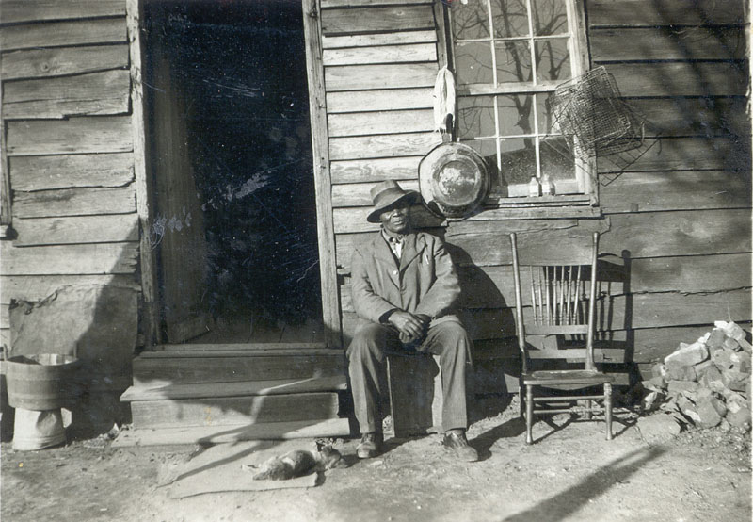
Questions?

