Slide 1
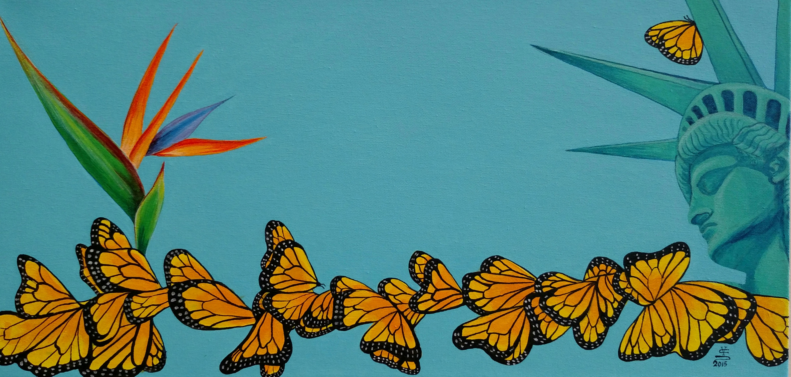
“So American it Hurts:” Stories of the 1.5 Generation Margarita Garcia Rojas

Slide 2
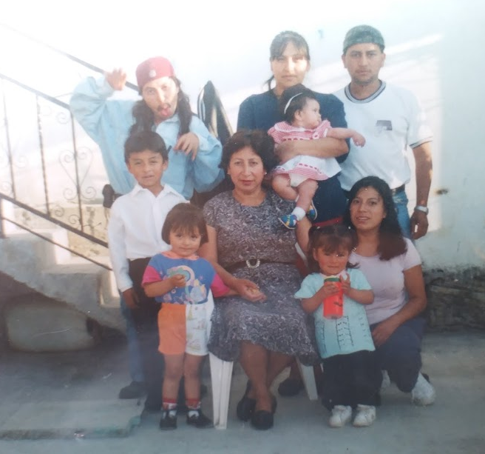
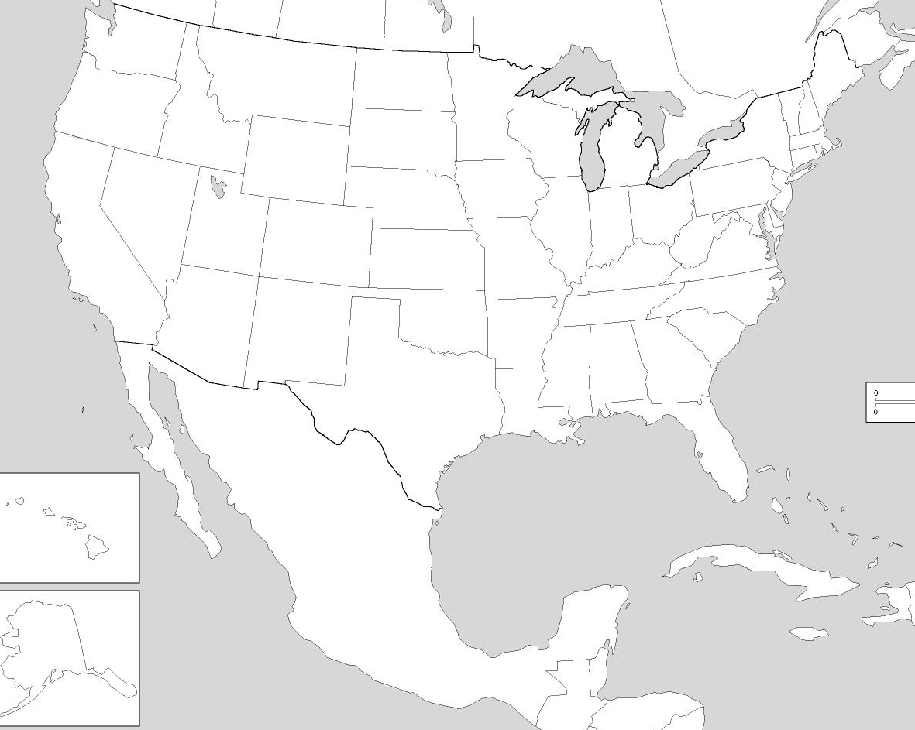
Me, Tio Fernando, Abuelita, Mom
Departure: Ciudad de México May 29, 2000
Arrival: Beloit, WI June 19, 2000

Slide 3
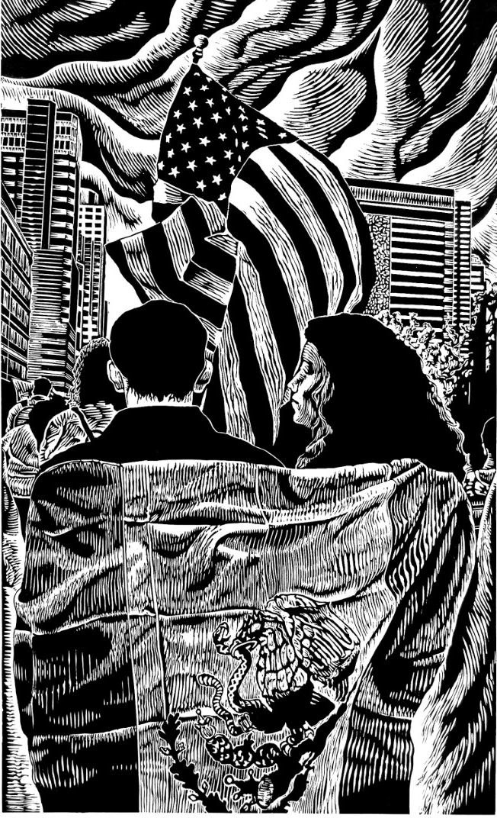
Who is Generation 1.5?
Children brought to the United States at a young age (before 12)
Despite legal status an established American identity can feel denied because of anti-immigrant policies and rhetoric.
Mixed Status family- If the individual is naturalized and have undocumented family members or vice versa
Shared challenge of balancing the traditional values of their native cultures while growing up American and trying to find themselves
DACA
Undocumented
Naturalized
Raoul Deal – “Ni de aquí, ni de allá”

Slide 4
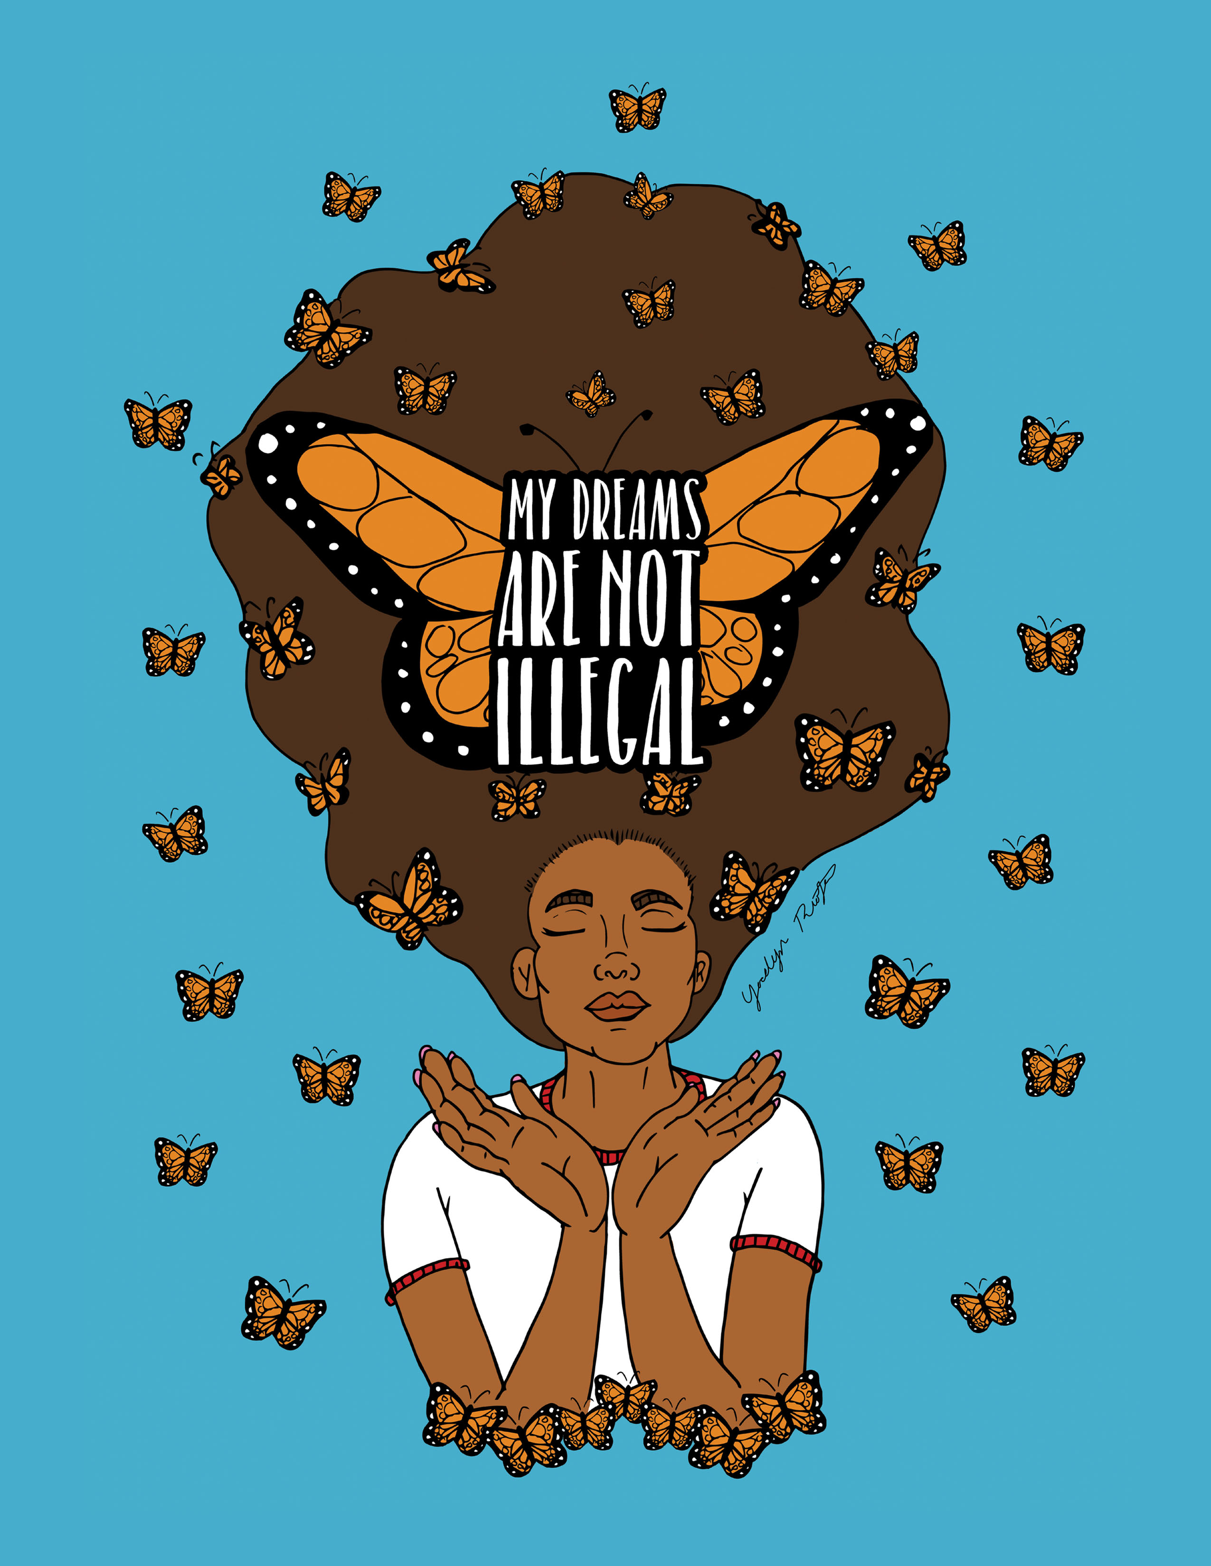
2001 - DREAM Act
2010 -The Dream Act of gets closer than previous attempts to passing but dies in the Senate
2012 - President Obama creates DACA
2016 - Donald Trump promises to end DACA as a candidate
2017 - Attorneys general threaten to sue if Trump does not rescind DACA by Sept. 5.
DACA Requirements:
1.Were under the age of 31 as of June 15, 2012;
2.Came to the United States before reaching your 16th birthday;
3.Have continuously resided in the United States since June 15, 2007, up to the present time;
4.Were physically present in the United States on June 15, 2012, and at the time of making your request for consideration of deferred action with USCIS;
5.Had no lawful status on June 15, 2012;
6.Are currently in school, have graduated or obtained a certificate of completion from high school, have obtained a general education development (GED) certificate, or are an honorably discharged veteran of the Coast Guard or Armed Forces of the United States; and
7.Have not been convicted of a felony, significant misdemeanor, or three or more other misdemeanors, and do not otherwise pose a threat to national security or public safety.
Yocelyn Riojas
Deferred Action for Childhood Arrivals & the Development, Relief and Education for Alien Minors (DREAM) Act
Overview

Slide 5
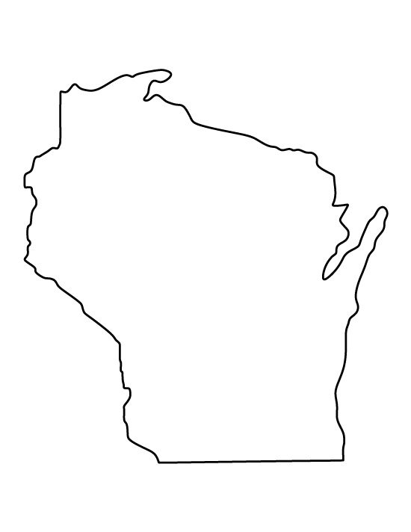
Research Question
Sample and Methods
How and to what extent do childhood experiences as an immigrant affect identity formation?
Sample: University students in Wisconsin who identify with being Generation 1.5 who are between 18-30 years old and would like to share their story..
Initial Google Form: Background information Sent to UWM Student Services Offices, student organizations across Wisconsin universities, social media , and other UWM and UW system professors
Interviews:
Conversational One hour Recording booth Maintain anonymity

Slide 6
Participant characteristics
Status Red – Naturalized
Green – DACA
Yellow – In process
Dark blue - Undocumented
Birthplace Mexico - 9
US - 1
Nicaragua - 1
Santiago, Chile - 1
Morocco - 1
Ethiopia - 1
France - 1
Age during migration
3 months
10 months
1, 2, 3, 4, 9, 11, 12,16
Have you ever experienced conflicts in the sense of your identity?
Blue – Yes
Red – No
Maybe – Yellow
Raised
California-US
CDMX/ San Luis Potosi
Wisconsin
Albany
Beloit
Kenosha
Madison
Milwaukee
Racine

Slide 7
Types of questions:
Biculturalism:
Can you share a moment of discrimination you’ve faced
How do you identify?
What kind of things did you do to stay connected to your culture or remember home?
Family:
What if your family like?
How is your relationship with them?
Do you have a lot of family in Mexico? If so, do you stay in contact with them?
Support services:
What was your experience growing up in _____?
Memories associated with these services
Did you receive any support growing up? If so, what kind? Possibly a church, organization, community center, etc. In U.S (Mexico?)
Community:
What was your community like when you moved to US?
Demographics
Definitions of home:
What if your definition of home?
What are your hopes for the future? Share final thoughts, comments.
My collection of oral histories of this group in Wisconsin aims to reveal how childhood experiences revolving:
biculturalism
family
support services
community
definitions of home affect their identity formation.

Slide 8
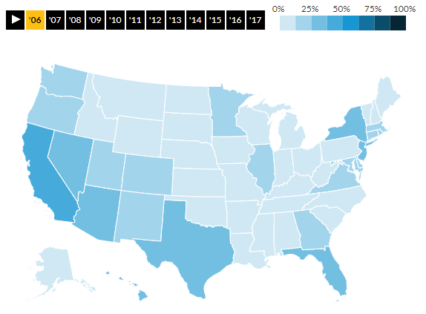
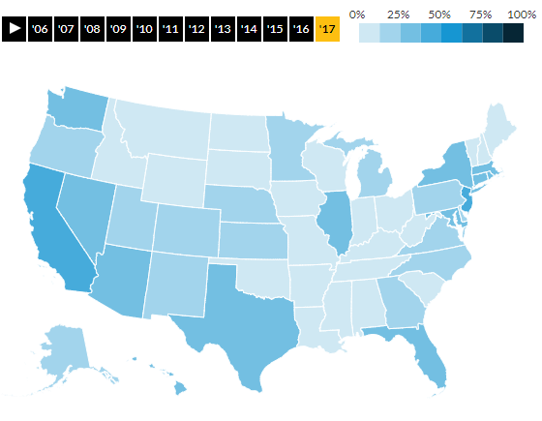
Local: Wisconsin:
06’- 8%
17’ -11%
Milwaukee:
10%-15%

Slide 9
These statistics should emphasize the fact that anti-immigrant policies and attitudes have serious implications on US born children and their family members that remain undocumented.
Focus on language , Department of Homeland Security
“Population Estimates ILLEGAL ALIEN POPULATION RESIDING IN THE UNITED STATES: JANUARY 2015”
Their definition of illegal aliens included DACA recipients and TPS holders

Slide 10
Participant: “C”
3 months - Mexico City
Dinner - Salsa & tortillas - Extreme poverty
Migration journey - Used by another female migrant on border
Kenosha, WI – Taken advantage of – look down on by woman that took her in
In Kenosha “you would only see the Mexican community at church”, there isn’t a community like there is here.
El Centro Hispano - A box of non perishables – one time
Mother relies on thrift stores – Moms in almost all cases were key in decision making and providing economic support
Mother is a hard worker but can not stay at one job for too long
“If it weren’t for my dad I wouldn’t be in school but if it wasn’t for her I wouldn’t be here”
“That was my childhood just watching my mom cry – I’m pretty sure it messed me up in some way”

Slide 11
Concluding Thoughts
Most participants never spoke about their status or their families in public not even to their best friends
Mothers were instrumental in the decision to leave and in providing economic and emotional support.
Location matters – in urban areas they felt more support compared to rural areas they were raised in
Future Work
Follow up with participants to see how their experiences continue to change and what are the causes.
Podcast – community access
Continue to build a more accurate narrative of who immigrants are and how their experiences differ.

